Slide 1
Software Testing and Quality Assurance
Lecture – 4

Slide 2
Agenda
Preparation for Lab on unit testing
Introduction to System Under Test (SUT)
Control-flow graph
Dataflow graph
Test Cases
Unit Testing in MSVC (C#)
Unit Testing in Eclipse (Java)

Slide 3
LAB PREPARATION

Slide 4
Testing Revisited
Goal of testing: maximize the number and severity of
defects found per dollar spent … thus: test early
Limits of testing: Testing can only determine the presence of defects, never their absence
use proofs of correctness to establish “absence”
Who should test: Someone other than the developer.
Why?

Slide 5
Testing – Revisited
3.
System tests
Include use-cases
2. Integration
tests
OO:
Packages of classes
Module combination
1.
Unit tests
Module
Combinations of methods in class
Function
Methods

Slide 6
RoadMap for Unit Testing
Requirements
1. Plan for unit testing
Identify largest trouble spots
Detailed design
Unit test plan
2. Design test cases and acquire test I/O pairs
Generate I/O pairs (often products of prior testing)
Test set
Code under test
3. Execute unit test
Test results
IEEE, 1986

Slide 7
Lab Problem
public int search(int key, int[] elemArray)
{
int bottom = 0; int top = elemArray.Length - 1; int mid; int index = -1; Boolean found = false;
while (bottom <= top && found == false) { mid = (top + bottom) / 2;
if (elemArray[mid] == key) {
index = mid; found = true; return index;
} else {
if (elemArray[mid] < key) bottom = mid + 1;
else
top = mid - 1;
}
}
return index;
}

Slide 8
Unit Testing with Visual Studio

Slide 9
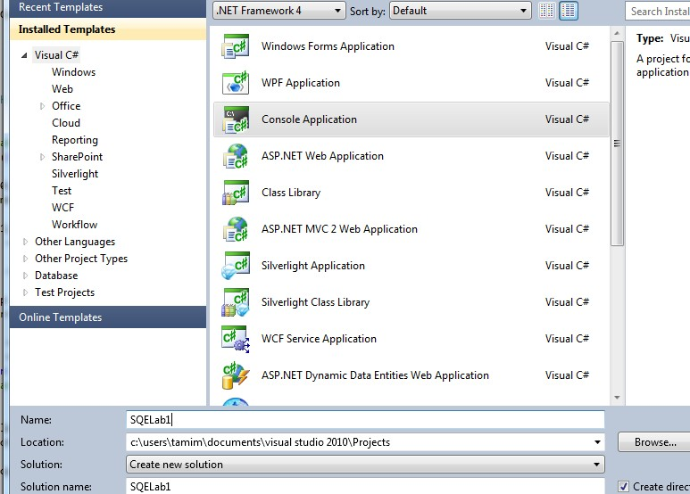
Opening C# Project
File -> New -> Project

Slide 10
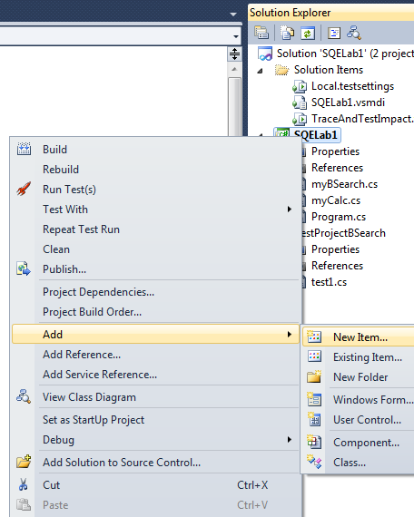
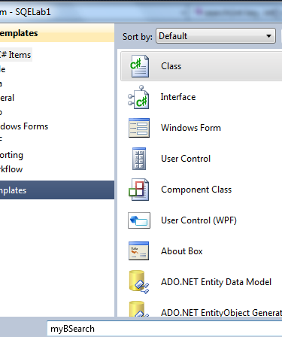
Add Class
Right Click on Project Name -> Add -> New Item

Slide 11
Code
using System;
using System.Collections.Generic; using System.Linq;
using System.Text;
mid = (top + bottom) / 2;
if (elemArray[mid] == key) { index = mid;
found = true; return index;
}
else {
if (elemArray[mid] < key)
bottom = mid + 1;
else
top = mid - 1;
}
namespace SQELab1 {
public class myBSearch {
public int search(int key, int[]
elemArray) {
int bottom = 0;
int top = elemArray.Length - 1; int mid;
int index = -1; Boolean found = false;
while (bottom <= top &&
found == false) {
}
return index;
}}
}

Slide 12
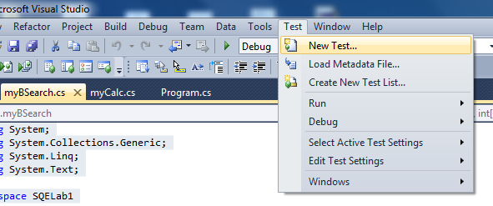
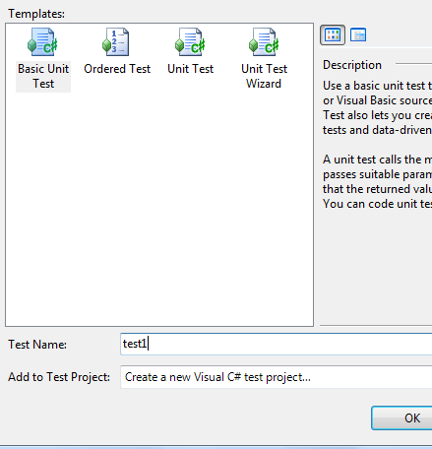
Add Test Project
Click on Test -> New Test

Slide 13
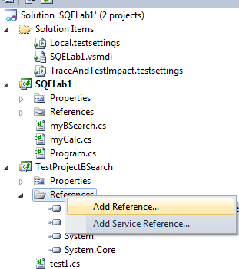

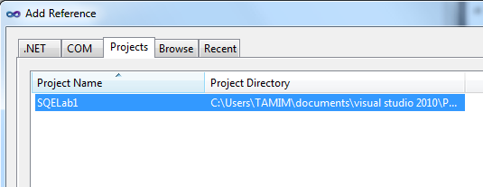
Add Test Project
Add reference to the SUT Project

Slide 14
Test Case Code
using System; using System.Text;
using System.Collections.Generic; using System.Linq;
using Microsoft.VisualStudio.TestTools.UnitTesting;
using SQELab1;
namespace TestProjectBSearch { [TestClass]
public class test1 { [TestMethod]
public void TestMethod1() {
int[] array = { 1, 2, 3, 4 }; int key = 1; myBSearch bs = new myBSearch();
Assert.AreEqual(1, bs.search(key, array));
}
}
}

Slide 15
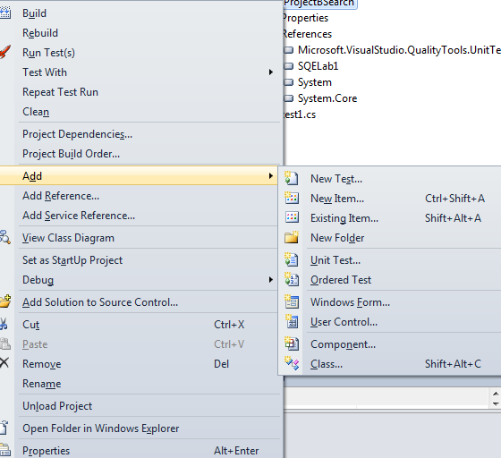
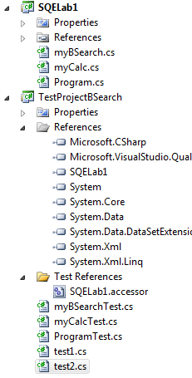
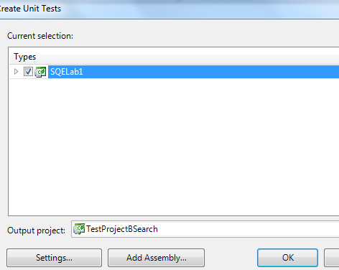
Adding another Unit Test

Slide 16
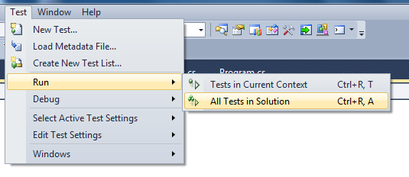
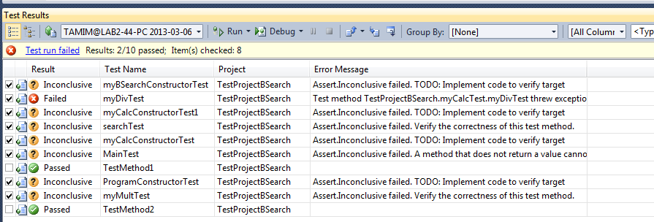
Execution of Tests

Slide 17
Questions…
We have the test machinery ready including
Code
Test stubs
Execution machinery
Coverage Report
– …
Do we have test cases
NO
We need to analyze code
Control-flow
Dataflow
Input space partitions
Decision Tables
– …

Slide 18
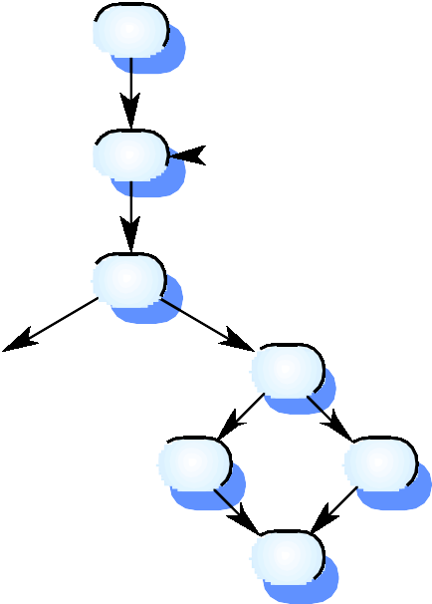


Control-Flow Graph
1
bottom > top
while bottom <= top
2
3
if (elemArray [mid] == key
8
4
(if (elemArray [mid]< key
5
6
9
7

Slide 19
Independent paths
1, 2, 3, 8, 9
1, 2, 3, 4, 6, 7, 2
1, 2, 3, 4, 5, 7, 2
1, 2, 3, 4, 6, 7, 2, 8, 9
Test cases should be derived so that all of these paths are executed
Test case
{1,2,3,4,5}, 1 which path is sensitized with this set of inputs?

Slide 20
Test Cases
Path | Condition | Test Case
1, 2, 3, 8, 9 | Bottom < top && found == false elemArray[mid] == key | 2, {1,2,3}, 1
1, 2, 3, 4, 6, 7, 2 | Bottom < top && found == false elemArray[mid] == key | ?
1, 2, 3, 4, 5, 7, 2 | Bottom < top && found == false elemArray[mid] == key | ?
1, 2, 3, 4, 6, 7, 2, 8, 9 | Bottom < top && found == false elemArray[mid] == key | ?

Slide 21
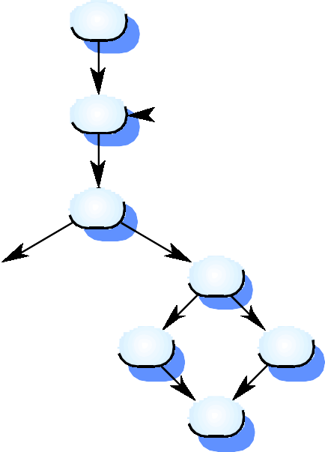
Dataflow Graph
Step No. 1: Consider Control-flow Path
1
bottom > top
while bottom <= top
2
3
if (elemArray [mid] == key
8
4
(if (elemArray [mid]< key
5
6
9
7

Slide 22
Dataflow Graph
Step No. 2:
1
int bottom = 0; int top = elemArray.Length - 1; int mid; int index = -1; Boolean found = false;
while (bottom <= top && found == false) {
mid = (top + bottom) / 2;
bottom > top
while bottom <= top
2
if (elemArray[mid] == key) { index = mid; found = true; return index;
if (elemArray [mid] == key
3
} else {
4
if (elemArray[mid] < key)
8
(if (elemArray [mid]< key
bottom = mid + 1;
5
6
else {
top = mid - 1;
9
7

Slide 23
Dataflow Graph
Step No. 3:
1
Def = {5}, C-Use = {0}. P-Use = {0}
Def = {1}, C-Use = {2}. P-Use = {3}
2
bottom > top
while bottom <= top
if (elemArray [mid] == key
3
Def = {0}, C-Use = {0}. P-Use = {0}
Def = {1},
C-Use = {2}. ₈
P-Use = {1}
4
Def = {0}, C-Use = {0}. P-Use = {1}
(if (elemArray [mid]< key
Def = {1},
C-Use = {1}.⁵
P-Use = {0}
6
Def = {1}, C-Use = {1}. P-Use = {0}
9
7

Slide 24
Path Sensitization
DCU Paths
– 1,2,3,8,9
DU Paths
– 1,2,3,4,6,7
We find out appropriate inputs for sensitization
– {1,2,3,4,5}, 3

Slide 25
Unit Testing with Eclipse

Slide 26
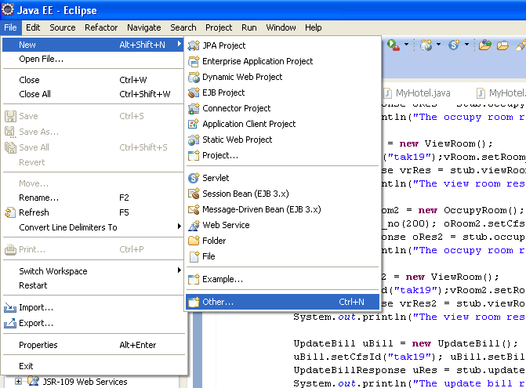
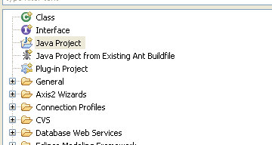
Opening Java Project in Eclipse
File -> New -> Other

Slide 27
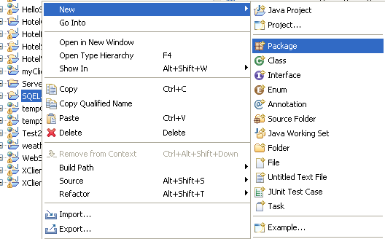
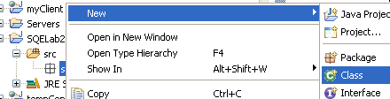
Add Package and Class
Right Click on Project Name -> Add -> New Item

Slide 28
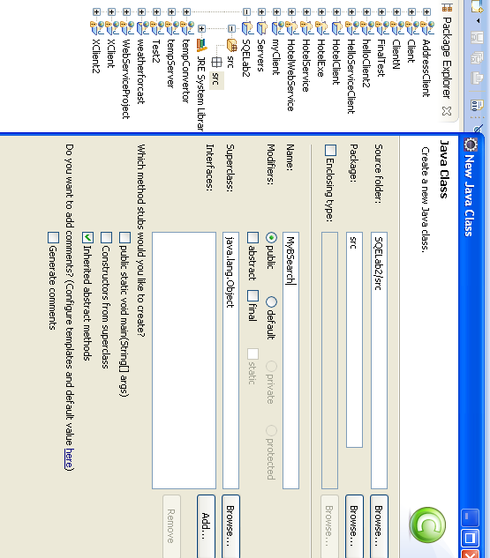
Right Click on Package and
Add Class

Slide 29
Code of Class (SUT)
package src;
public class MyBSearch {
public int search(int key, int[] elemArray) {
int bottom = 0; int top = elemArray.length - 1; int mid; int index = -1; boolean found = false; while (bottom <= top && found == false) {
mid = (top + bottom) / 2;
if (elemArray[mid] == key) {
index = mid; found = true; return index; }
else{
if (elemArray[mid] < key)
bottom = mid + 1;
else
top = mid - 1;
} }
return index; }
}

Slide 30
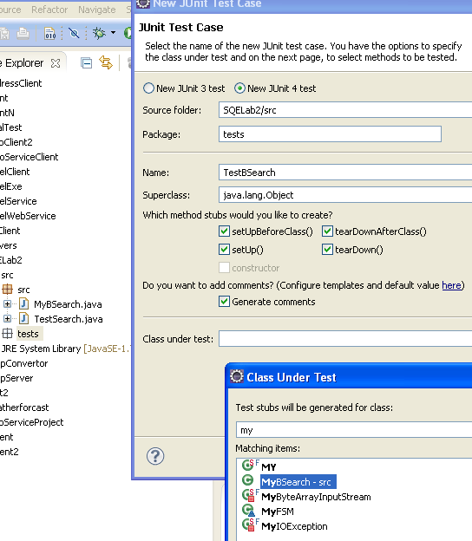
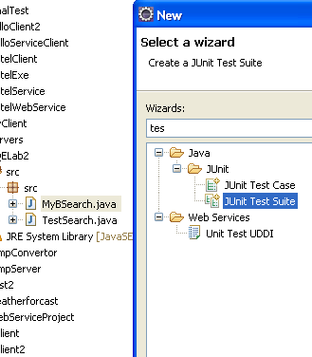
Add Test Case and Test Suite
Rt. Click Project Name -> Other -> …

Slide 31
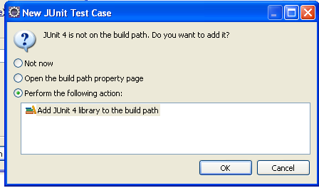
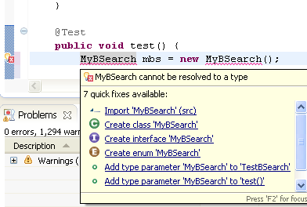
Add Test Project
Add reference to the SUT Project

Slide 32
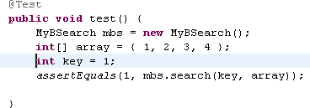
Test Case

Slide 33
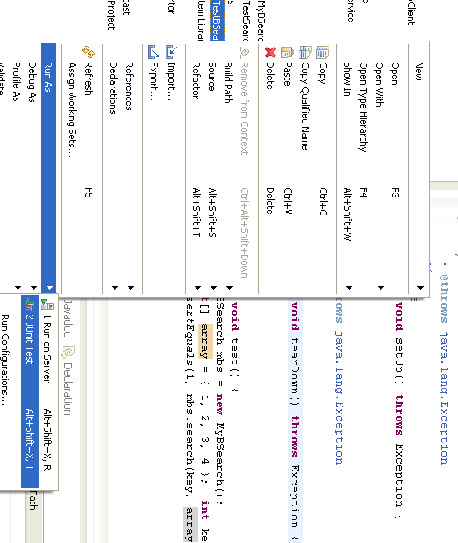
Running a Test Case

Slide 34
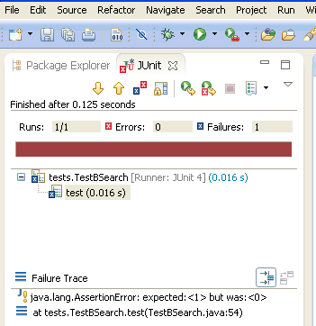
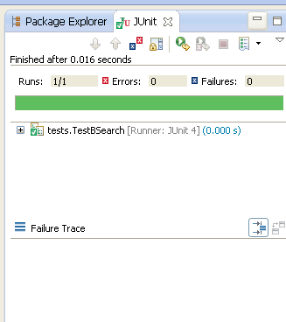
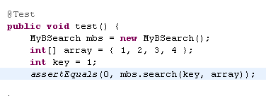
Test Case (Pass and Fail)

Slide 35
A look at the Test Case Code
package tests;
@After
import static org.junit.Assert.*;
public void tearDown() throws Exception {
}
import org.junit.After; import org.junit.AfterClass; import org.junit.Before; import org.junit.BeforeClass; import org.junit.Test;
@Test
public void test() {
MyBSearch mbs = new
MyBSearch(); int[] array = { 1, 2, 3, 4 };
int key = 1; assertEquals(
0, mbs.search(key, array));
import src.MyBSearch;
public class TestBSearch {
@Before
public void setUp() throws Exception {
}
}
}

Slide 36
Questions… (Revisited)
We have the test machinery ready including
Code
Test stubs
Execution machinery
Coverage Report
– …
Do we have test cases
NO
We need to analyze code
Control-flow
Dataflow
Input space partitions
Decision Tables
– …
What are the measures to test sufficiency of testing?

Slide 37
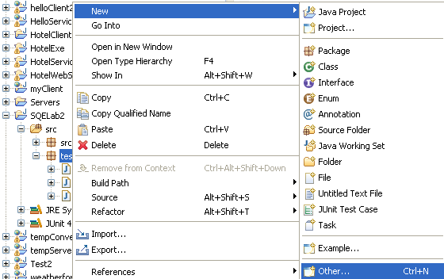
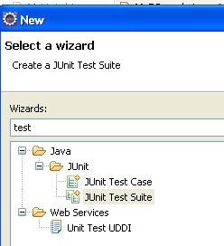
Add More Test Cases in Test Suite

Slide 38
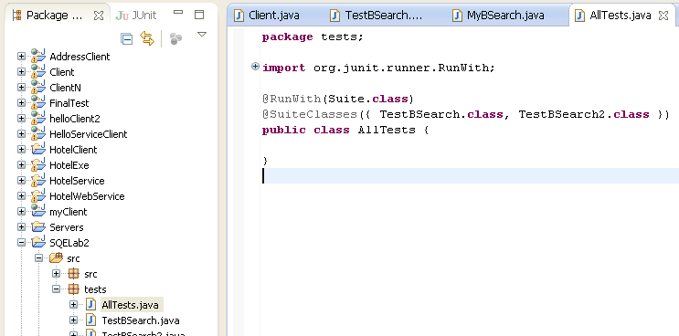
Test Suite

Slide 39
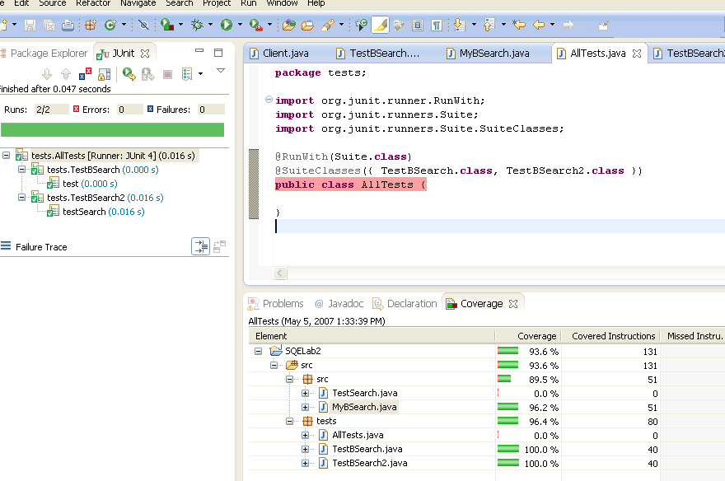
Test Suite

Slide 40
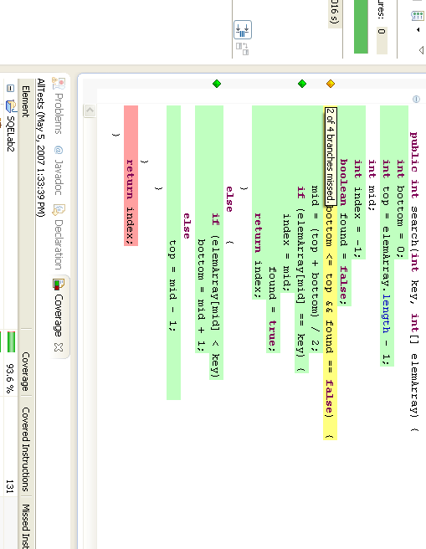
Code Analysis

Slide 41
Findings
Statement coverage is weaker than branch coverage criteria
We can find out if branches are missed from coverage analysis
We get several different coverage reports

Slide 42
Summary
We needed knowledge of both
How to derive test cases
How to execute test cases
We needed
Coverage analysis
Confidence measure
Input space partitioning
Decision tables
– …
To say if the generated test cases were enough
Since we can exhaustively test an SUT

Slide 43
Coverage

Slide 44
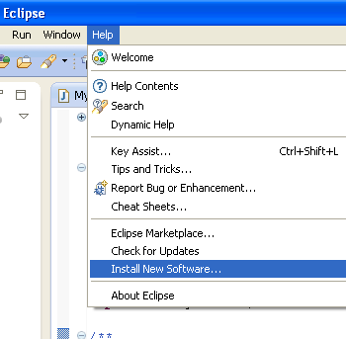
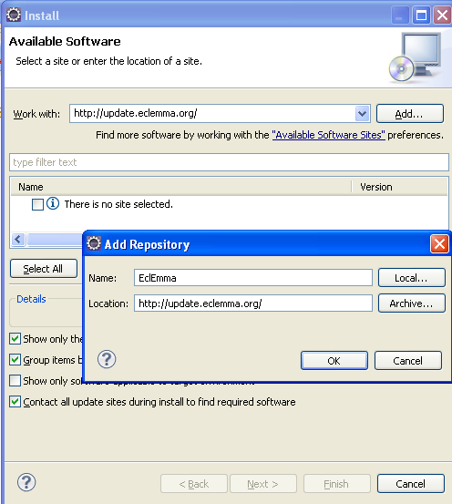
Coverage – Installing EclEmma

Slide 45
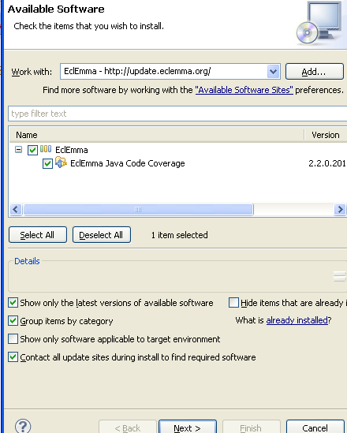
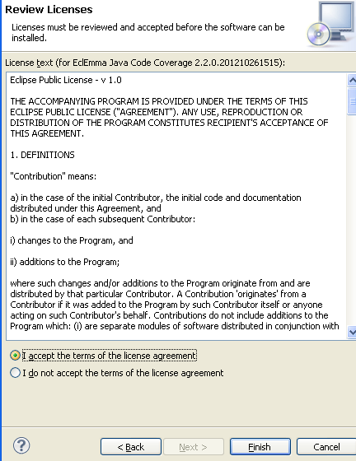
Installing EclEmma

Slide 46
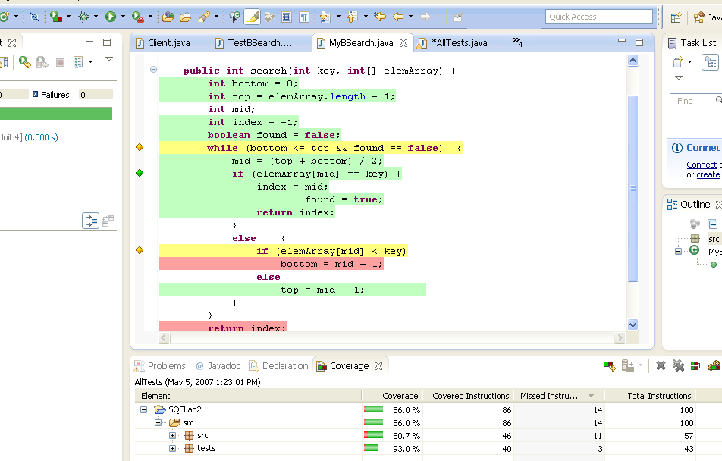
Covered and uncovered Code

Slide 47


Equivalence Partitions with Boundary value analysis
Array empty | Array with 10 elements | > 10 elements
Key not present | Key present once | Present more than once

Slide 48
Binary search equiv. partitions
Equivalence class boundaries
Elements < Mid
Elements > Mid
Mid-point

Slide 49
Binary search - test cases
Input array (T) | Key (Key) | Output (Found, L)
17 | 17 | true, 1
17 | 0 | false, ??
17, 21, 23, 29 | 17 | true, 1
9, 16, 18, 30, 31, 41, 45 | 45 | true, 7
17, 18, 21, 23, 29, 38, 41 | 23 | true, 4
17, 18, 21, 23, 29, 33, 38 | 21 | true, 3
12, 18, 21, 23, 32 | 23 | true, 4
21, 23, 29, 33, 38 | 25 | false, ??

Slide 50
Summary
We needed knowledge of both
How to derive test cases
How to execute test cases
We needed
Coverage analysis
Confidence measure
Input space partitioning
Decision tables
– …
To say if the generated test cases were enough
Since we can exhaustively test an SUT

